Slide 1
The Basic Logic of Computational Neuroscience
Xiaokai Xia
xia@xiaokai.me
School of Psychology
South China Normal University

Slide 2
The outline
What is Cognitive Computational Neuroscience
Example: Bayesian model in perceptual research
The basics of CCN

Slide 3
What is Computational Neuroscience
Computational Model based cognitive research
with neural evidence

Slide 4
What’s the cognitive psychology
Aim
Understand Mental Processes
Guide theory
Computer metaphor
Solso, R. L., MacLin, M. K., & MacLin, O. H. (2005). Cognitive psychology (7th ed.). Pearson Education New Zealand.

Slide 5
Computer metaphor
Cognition == Information processing
Using model to describe it

Slide 6
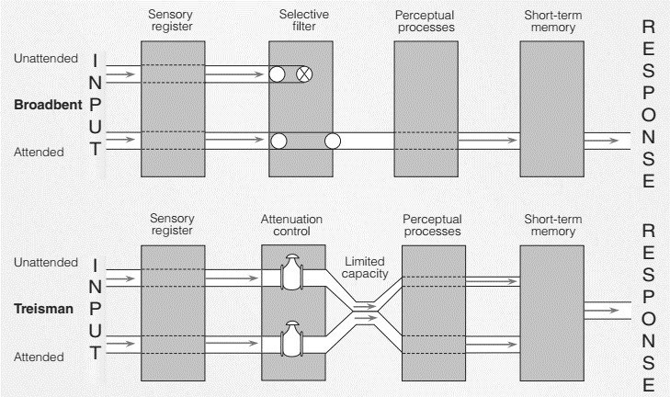
Computer metaphor
Attenuation Model in Cognitive Psychology
Broadbent,. E. (1958). Effect of noise on an “intellectual” task. The Journal of the Acoustical Society of America, 30(9)
Treisman, A. D (1964). SELECTIVE ATTENTION IN MAN. British medical bulletin, 20, 12-6 .

Slide 7
Model and Computational Model
Model is a abstraction of a real system which can
Simulate the phenomenon
Be understood easily
Be controlled
Computational Model is a model can be
Described by mathematical concepts
Calculated based on mathematical rules
Simulated by computer
Gunnar Blohm (2020). NMA W1D1

Slide 8
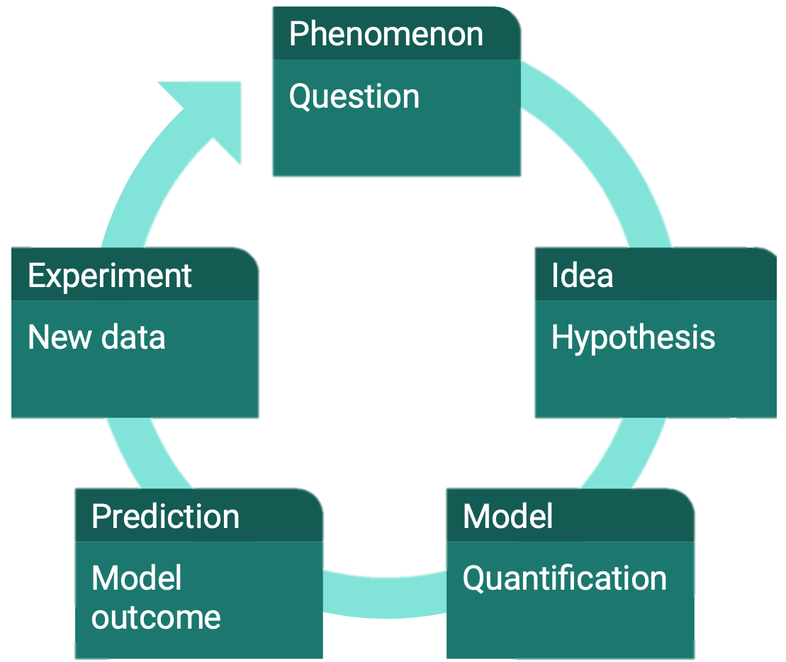
The basic logic in model-based research

Slide 9
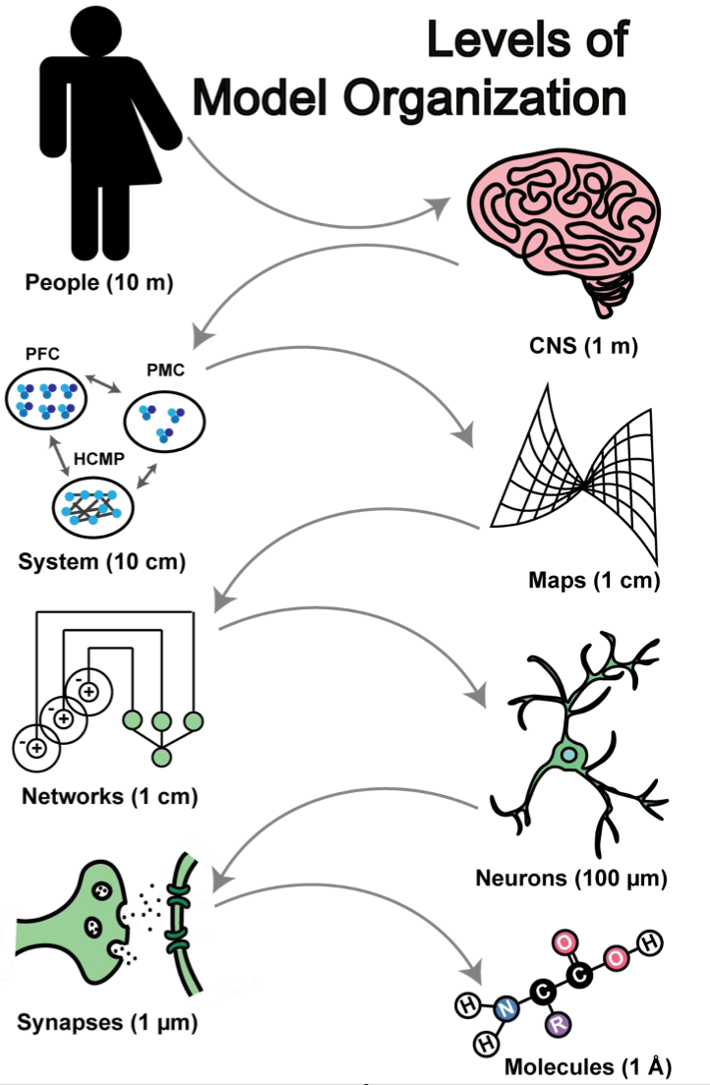

Build model in different scale
Why
How
What
Modified from Trappenberg (2009), Fundamentals of Computational Neuroscience

Slide 10
The model pyramid
Why
How
What
Describe Model
Dayan & Abbott (2001)

Slide 11
The model pyramid
Why
How
Mechanistic Model
What
Describe Model
Dayan & Abbott (2001)

Slide 12
The model pyramid
Why
Interpretive / explanatory
How
Mechanistic Model
What
Describe Model
Dayan & Abbott (2001)

Slide 13
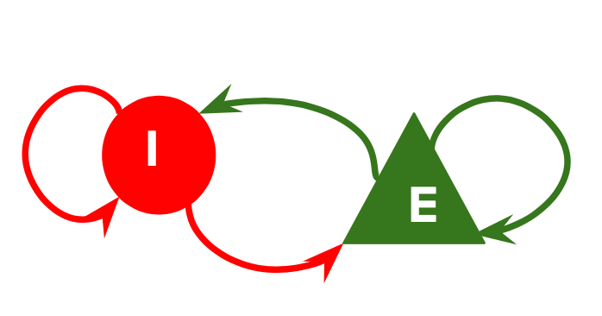
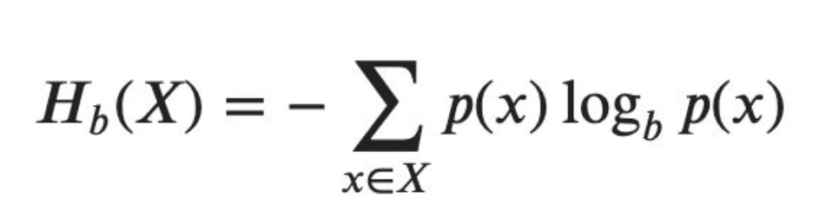
E.g. The interspike interval (ISI) model
What: We can use a Poisson process to describe
How: LIF principle can make neurons spike like this
Why: Shannon entropy → transmit 5 – 30 bit / s

Slide 14
Different Model Levels
Dayan’s Model
David Marr’s Model
Why
How
What
Implementation
Algorithmic
Computational
Marr, D. (2010). Vision : A computational investigation into the human representation and processing of visual information / David Marr. Cambridge, Mass.: MIT Press.

Slide 15
David Marr’s Model
Implementation
Algorithmic
Computational
What the physiological mechanisms that bring about these representations and carry out these algorithms?
What representations and procedures are used in the neural computation?
What computations does the central nervous system perform and why?
Marr, D. (2010). Vision : A computational investigation into the human representation and processing of visual information / David Marr. Cambridge, Mass.: MIT Press.

Slide 16
Why we love model?
Knowledge synthesis
Mechanistic insights
Retrieve latent information
Guidance in designing useful experiments
Inspire new technologies / applications
Gunnar Blohm (2020), NMA

Slide 17
A simple example
Bayesian model of sensory perception
and the evidence in neuroimage

Slide 18
A basic process in CCN
Question Definition
Find a phenomenon
Know the edge of it and find the entry point
Build a mathematic hypothesis
Modeling
Find a suitable mathematic tool
Plan and build the model
Model Testing
Simulate the phenomenon (Quantitative & Qualitative)
Publication
E.g. GitHub

Slide 19
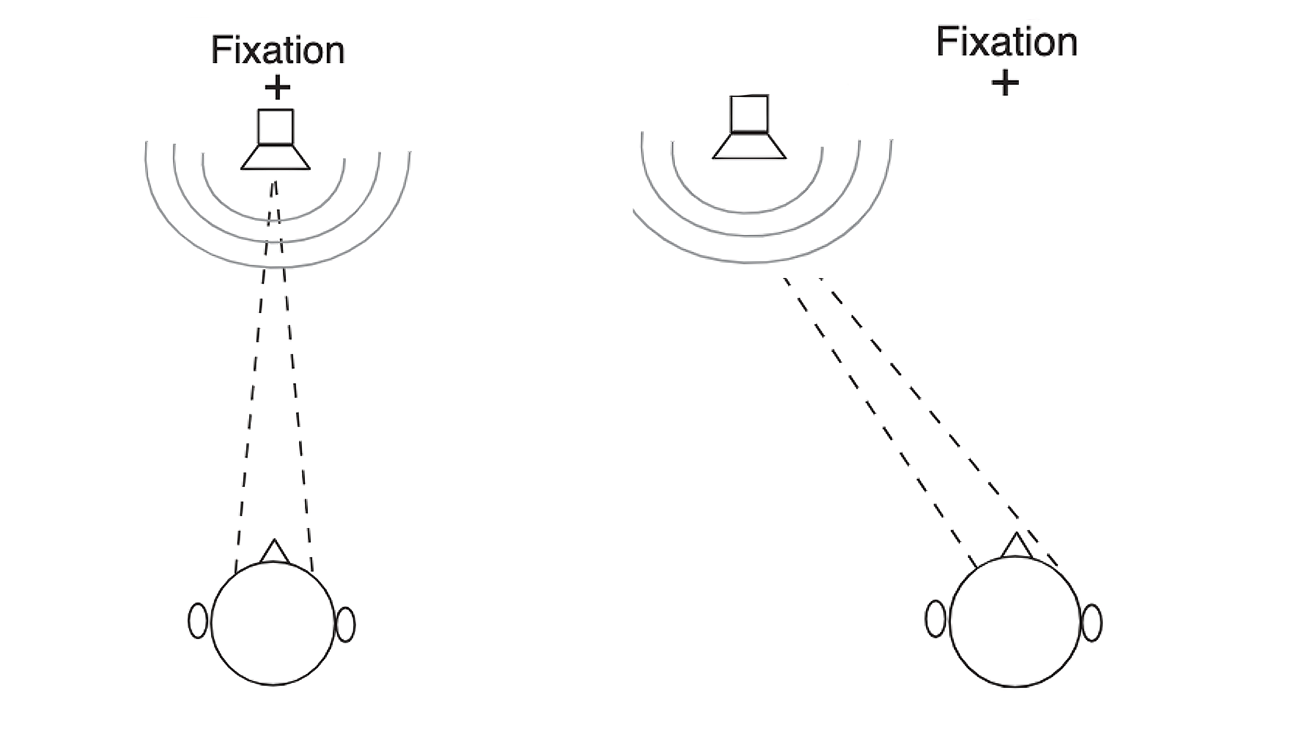
Phenomenon
Knill, D., Pouget, A. (2004). The Bayesian brain: the role of uncertainty in neural coding and computation Trends in Neurosciences 27(12), 712-719. https://dx.doi.org/10.1016/j.tins.2004.10.007

Slide 20
Define the Question
P: The information in brain is imperfect
Sensors is variability
Environment is unstable
Q: How we can know the optimal parameters
H: We do Bayesian inference in brain
Using distribution to represent the uncertainty
Using Bayes rule to update and inference data
Knill, D., Pouget, A. (2004). The Bayesian brain: the role of uncertainty in neural coding and computation Trends in Neurosciences 27(12), 712-719. https://dx.doi.org/10.1016/j.tins.2004.10.007

Slide 21
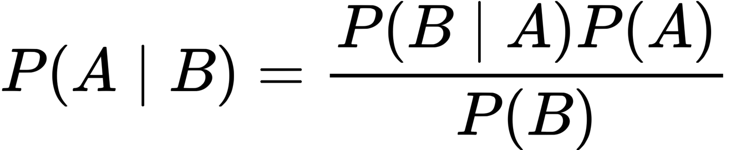
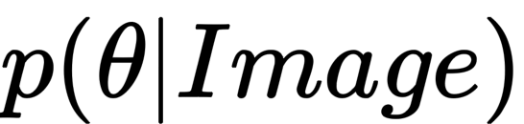
Brief intro about Bayes Brain
Bayesian Probability describe belief
Conditional Probability updated by Bayes rule
Brain encode context parameters in Bayesian way
Frequentist statistics
Bayesians statistics
Knill, D., Pouget, A. (2004). The Bayesian brain: the role of uncertainty in neural coding and computation Trends in Neurosciences 27(12), 712-719. https://dx.doi.org/10.1016/j.tins.2004.10.007

Slide 22
Model Implementation
Perspective on the issue
Pure Mathematics or Logic
Code Engineering
Neurological feasibility
Toy model
Implement Basic Elements
How to represent the information
How to combine information from different sources
Simulation model
Simulate the psychological phenomenon
Evaluate the model Accuracy
Xiaokai Xia (2020), My Experience

Slide 23
Toy model
Code
Mathematics
Representation

Slide 24
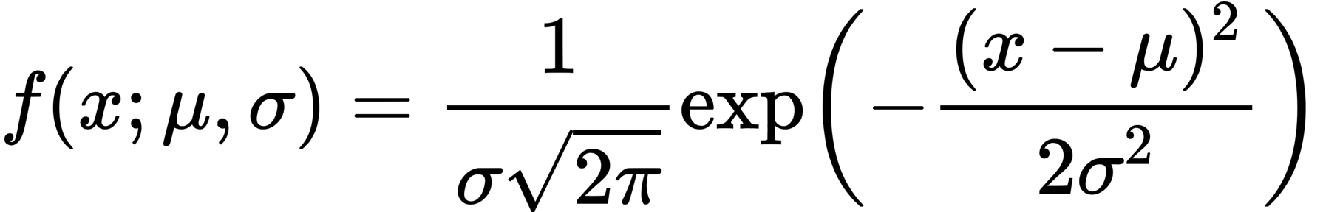
Toy model
Information Representation
Code
Representation

Slide 25
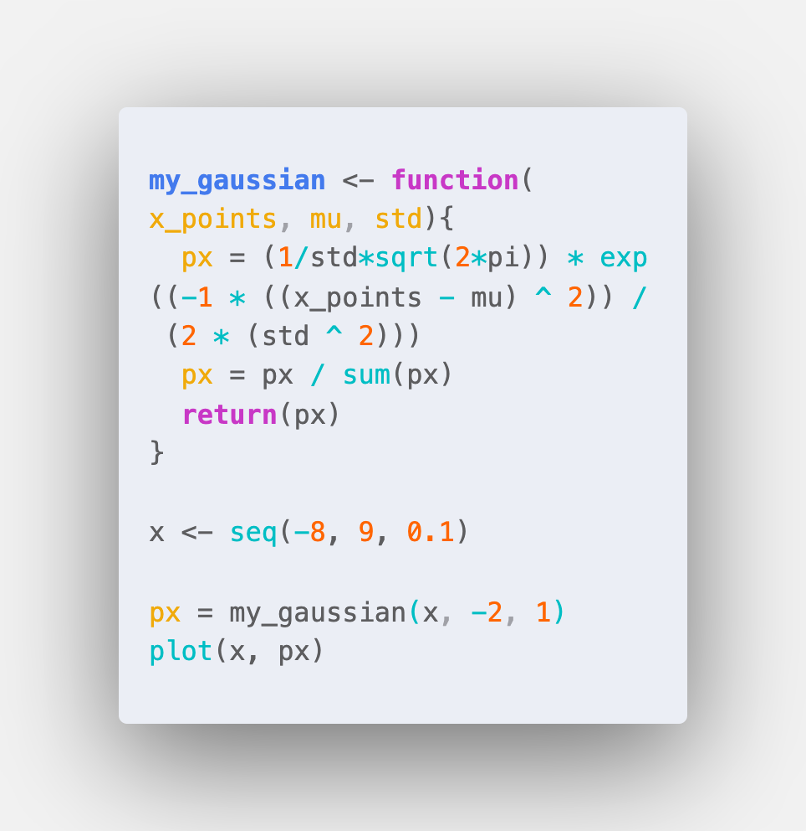
Toy model
Information Representation
Representation

Slide 26
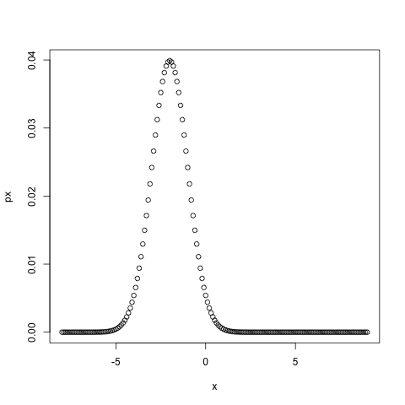
Toy model
Information Representation

Slide 27
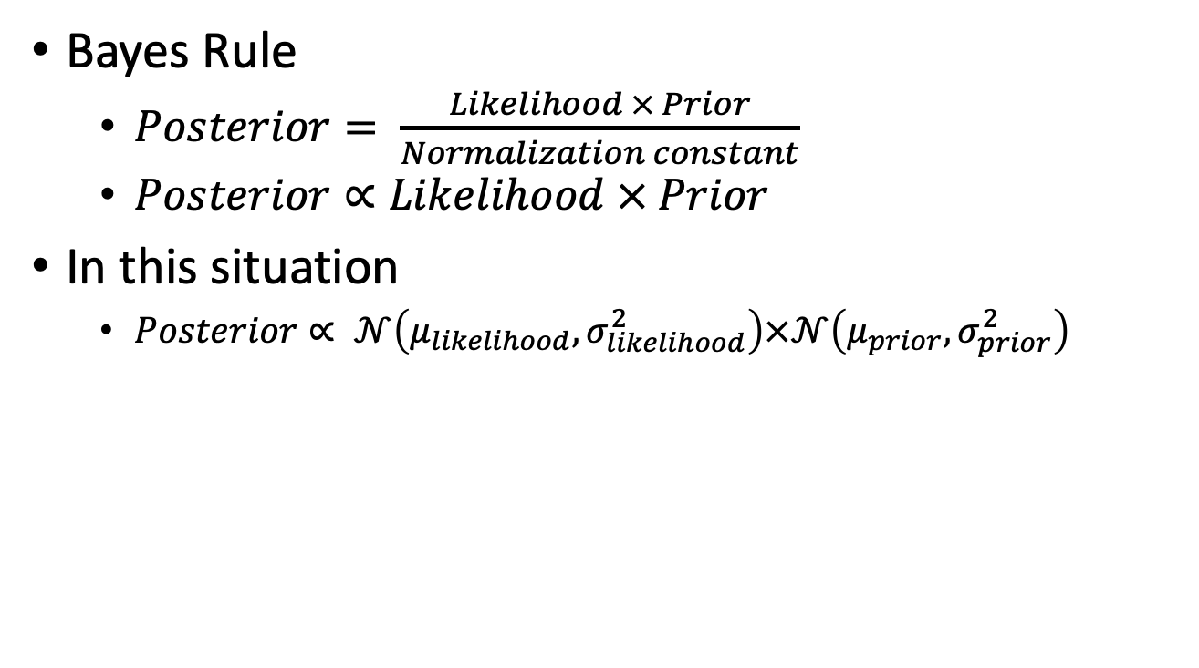
Toy model
Information Update
Bayes Rule
$Posterior= \frac{Likelihood × Prior}{Normalization constant}$
$Posterior∝Likelihood × Prior$
In this situation
$Posterior∝ 𝒩\left(μ_{likelihood}, σ_{likelihood}^{2}\right)×𝒩\left(μ_{prior}, σ_{prior}^{2}\right)$

Slide 28
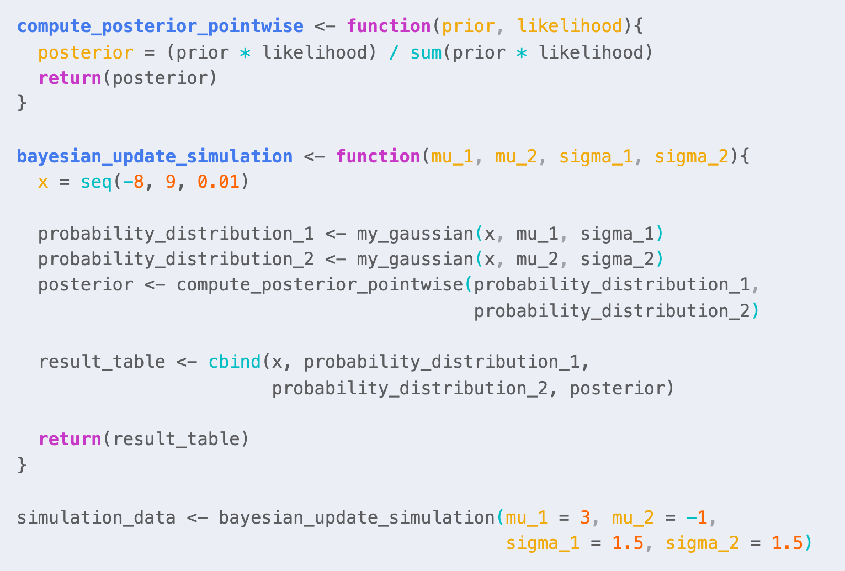
Toy model
Information Update

Slide 29
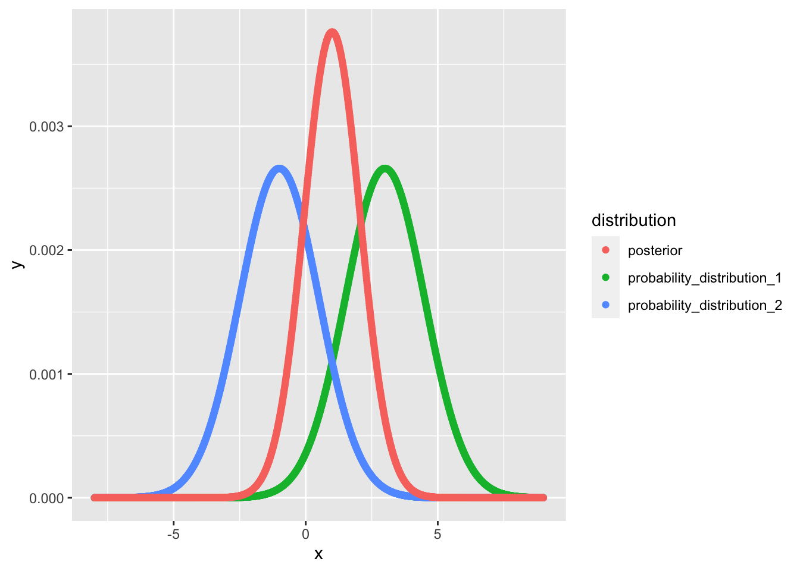
Toy model
Information Update

Slide 30
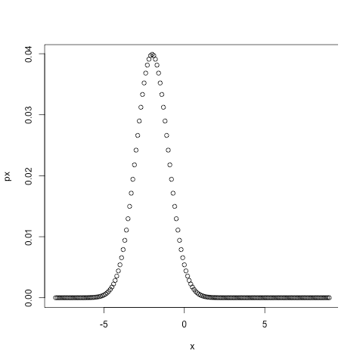

Toy model
The gap between formula and computational implement
GAP!

Slide 31

Toy model
The gap between formula and computational implement
GAP!
symbolic computation
Numeric computation

Slide 32
Simulation model
Phenomenon
Kording (2020), NMA W2D1

Slide 33
Simulation model
Phenomenon
Before the curtain fell, subject learned
65% of the time, the voice originates from the puppet
35% of trials, sounds come from elsewhere
After the curtain fell, see the puppet
Ask the subject about the voice location
Kording (2020), NMA W2D1

Slide 34
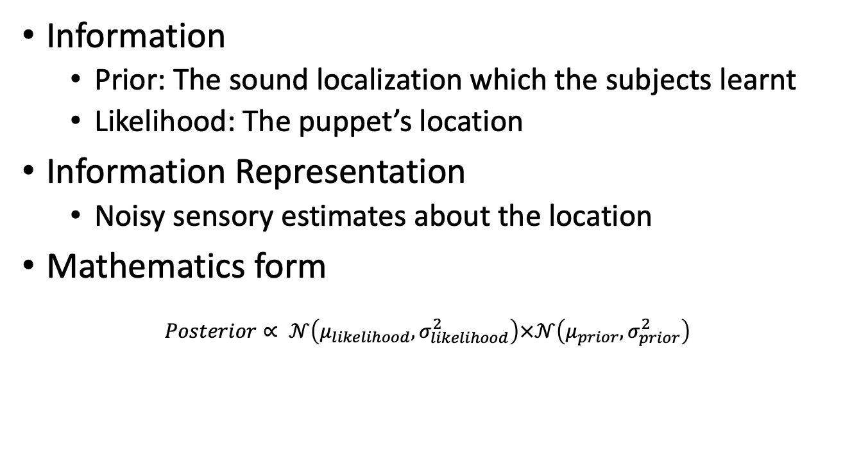
Simulation model
Mathematics Process
Information
Prior: The sound localization which the subjects learnt
Likelihood: The puppet’s location
Information Representation
Noisy sensory estimates about the location
Mathematics form
$$Posterior∝ 𝒩\left(μ_{likelihood}, σ_{likelihood}^{2}\right)×𝒩\left(μ_{prior}, σ_{prior}^{2}\right)$$
Kording (2020), NMA W2D1

Slide 35
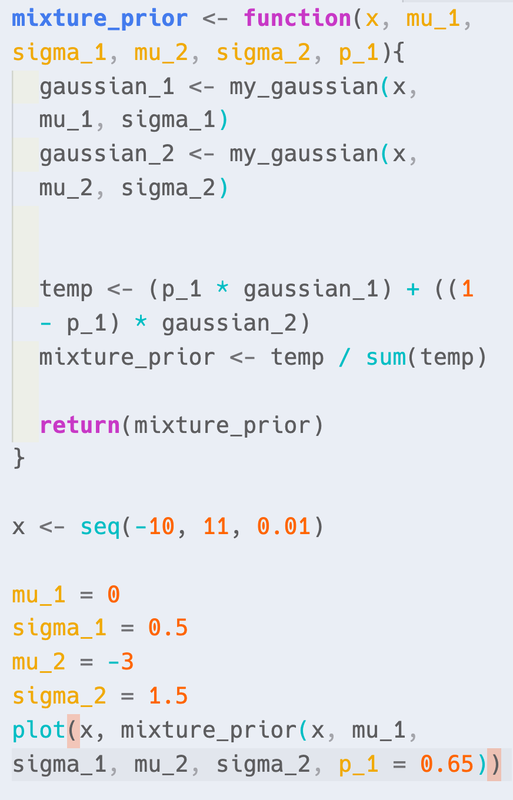
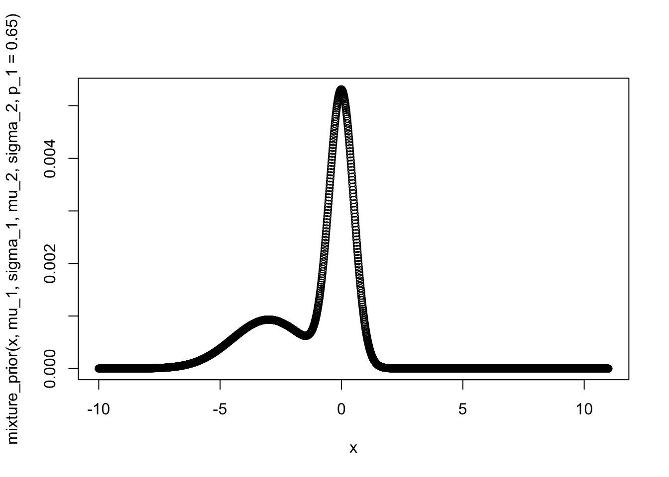
Simulation model
Code implement

Slide 36
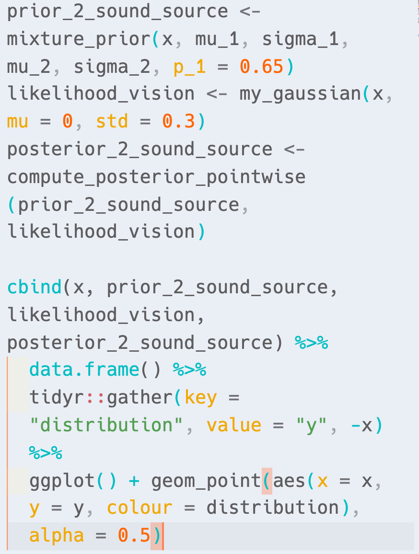
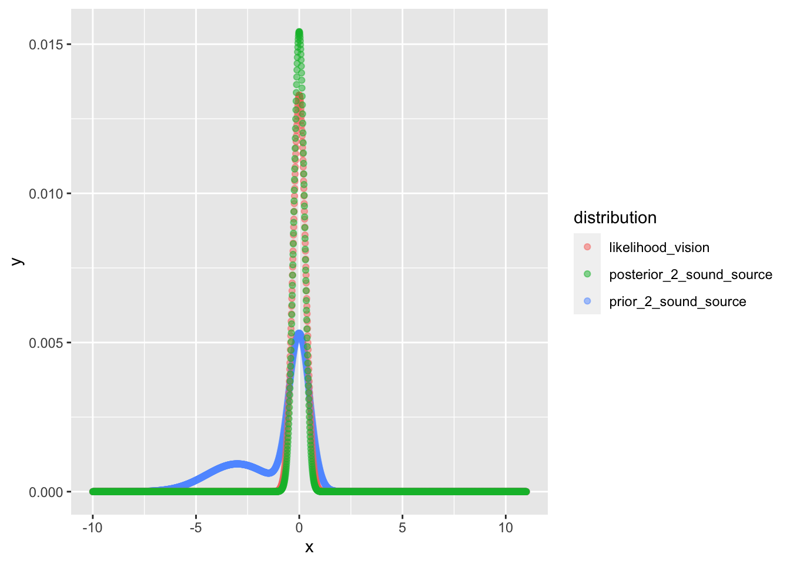
Simulation model
Code implement

Slide 37
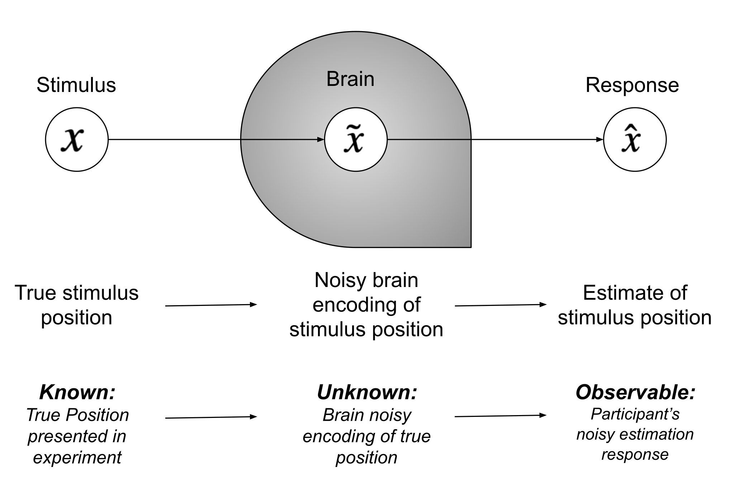
Kording (2020), NMA W2D1

Slide 38
Taking a step further
Probability inference
Conceptual learning

Slide 39
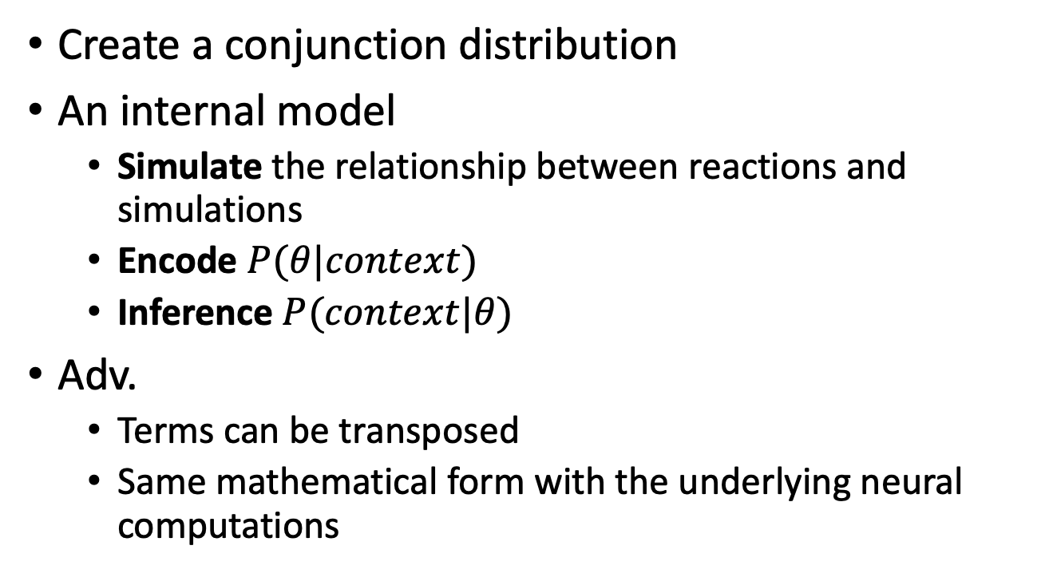
Generative Model
Create a conjunction distribution
An internal model
Simulate the relationship between reactions and simulations
Encode $P(θ|context)$
Inference $P(context|θ)$
Adv.
Terms can be transposed
Same mathematical form with the underlying neural computations
Solway, A., Botvinick, M. (2012). Goal-Directed Decision Making as Probabilistic Inference: A Computational Framework and Potential Neural Correlates Psychological Review 119(1), 120-154. https://dx.doi.org/10.1037/a0026435

Slide 40
Simulation model
Mathematics Process
Build a generative model to simulate
Creating a mixture of Gaussian prior for multiple possible stimulus inputs
Generating the likelihood for multiple possible stimulus inputs
Estimating our posterior as a function of the stimulus input
Estimating a participant response given the posterior
Formula form & Code is omitted

Slide 41
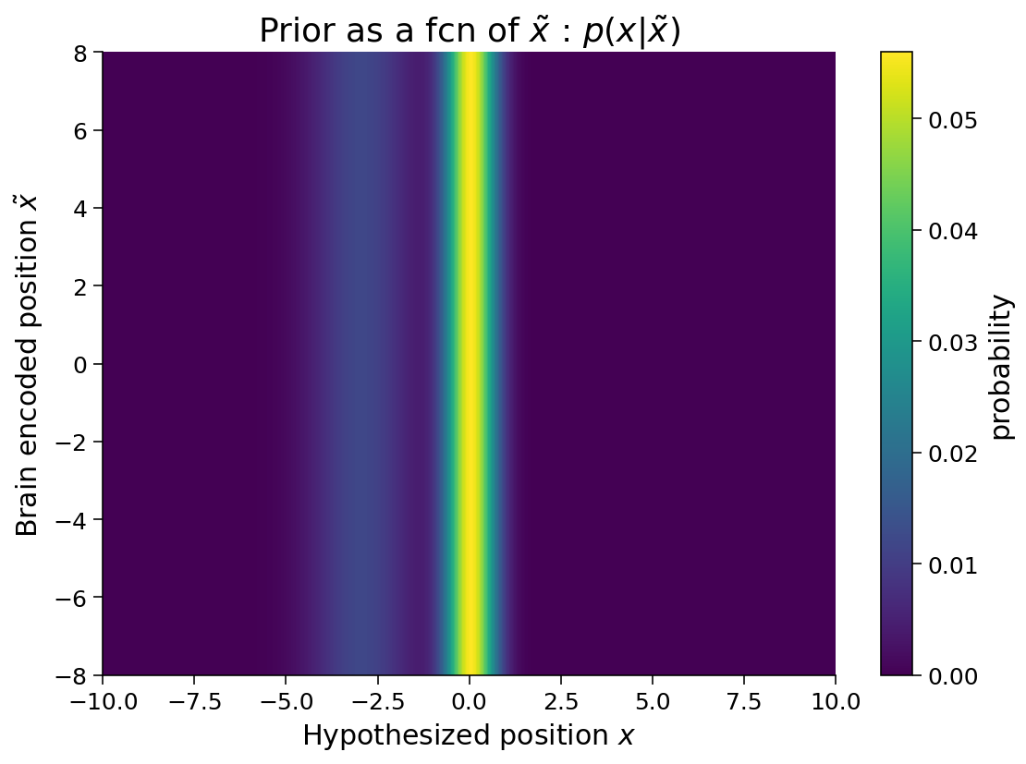
Simulation model
Prior

Slide 42
Simulation model
Prior

Slide 43
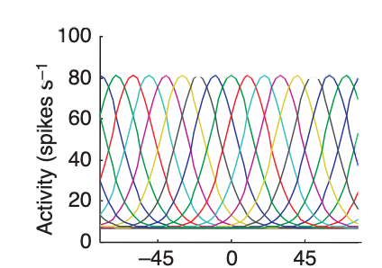
Simulation model
Multi-likelihood
Knill, D., Pouget, A. (2004). The Bayesian brain: the role of uncertainty in neural coding and computation Trends in Neurosciences 27(12), 712-719. https://dx.doi.org/10.1016/j.tins.2004.10.007

Slide 44
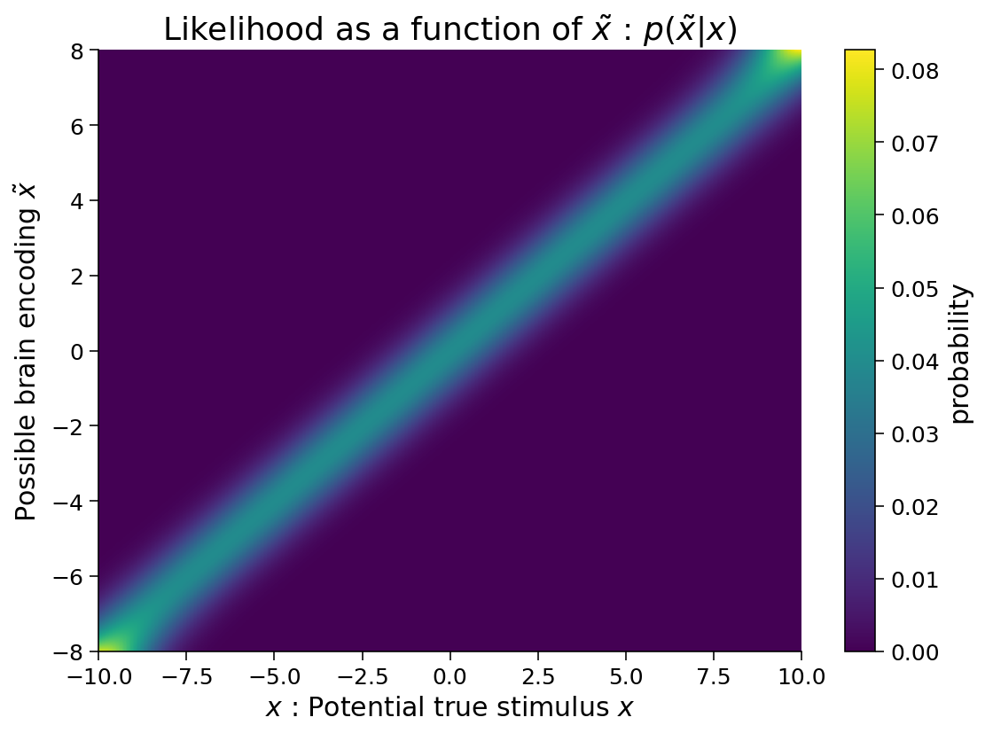
Simulation model
Multi-likelihood

Slide 45
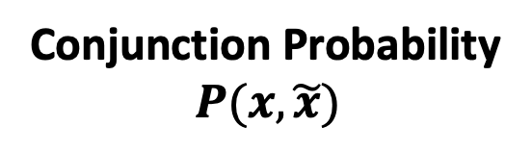
Simulation model
Conjunction Probability
$$P(x, \tilde{x})$$
Prior
Likelihood

Slide 46
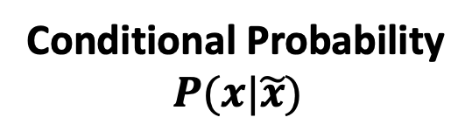
Simulation model
Conditional Probability
$$P(x|\tilde{x})$$
Prior
Likelihood

Slide 47
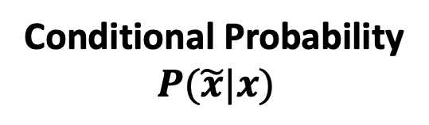
Simulation model
Conditional Probability
$$P(\tilde{x}|x)$$
Prior
Likelihood

Slide 48
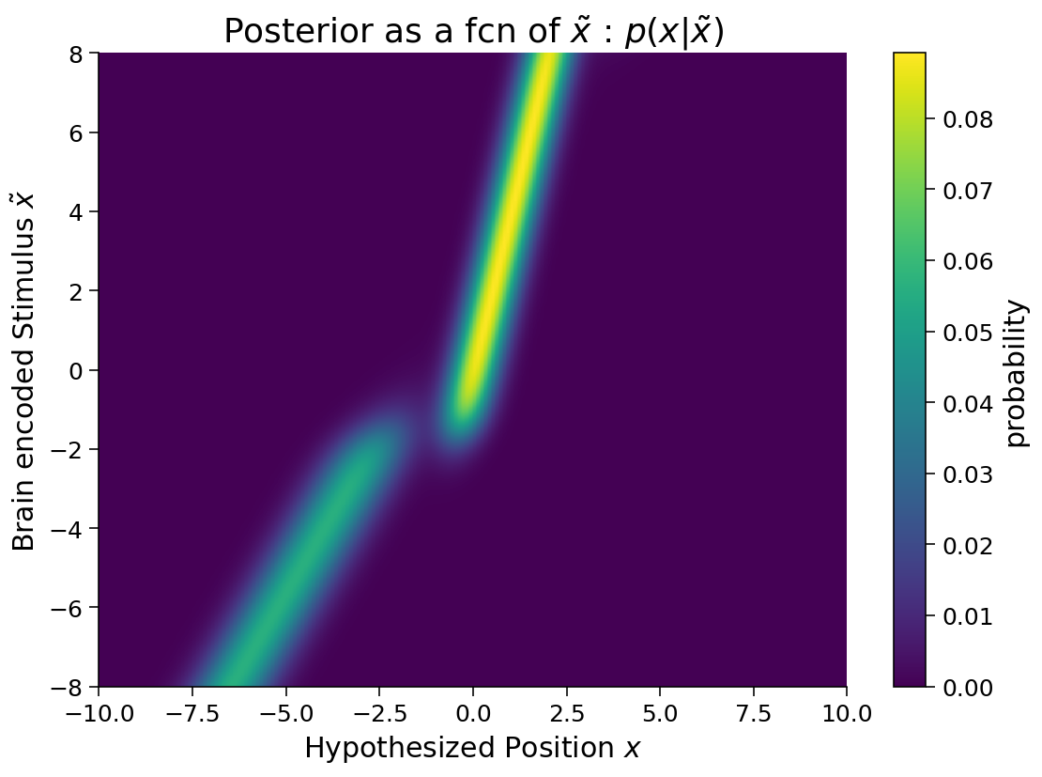
Simulation model
Posterior

Slide 49
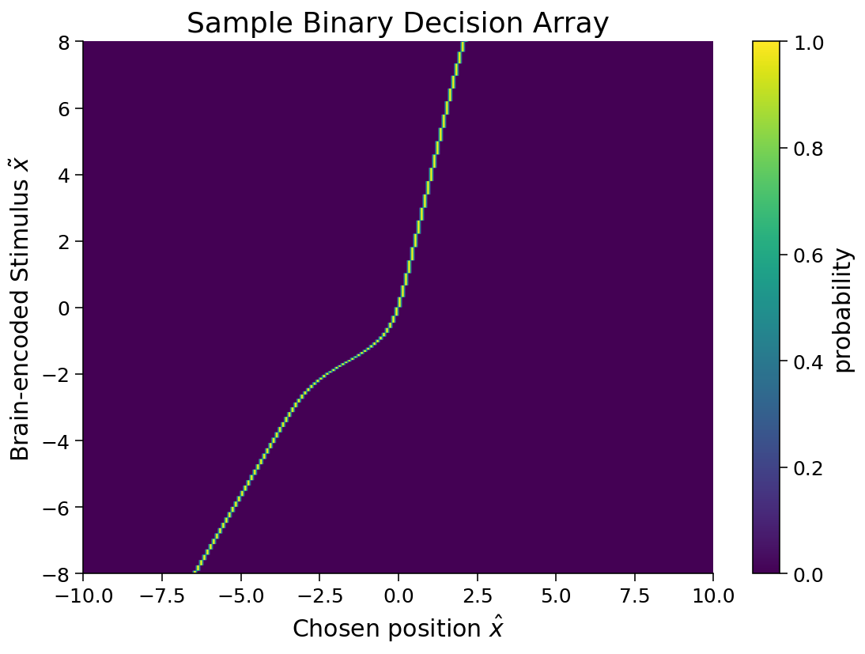
Simulation model
Binary decision matrix

Slide 50
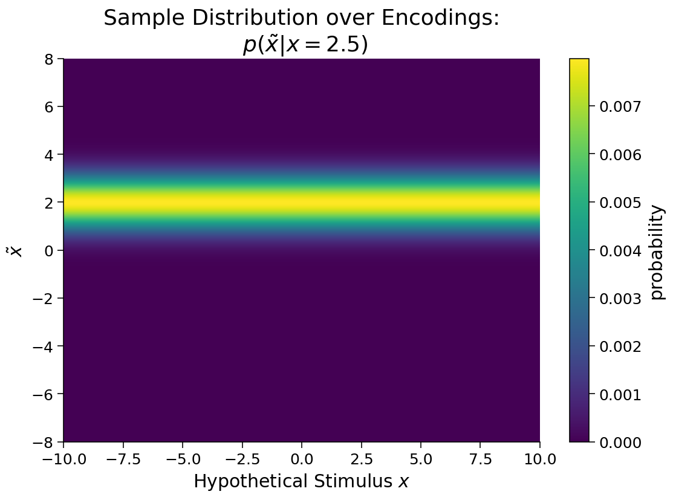
Simulation model
Inference the true x

Slide 51
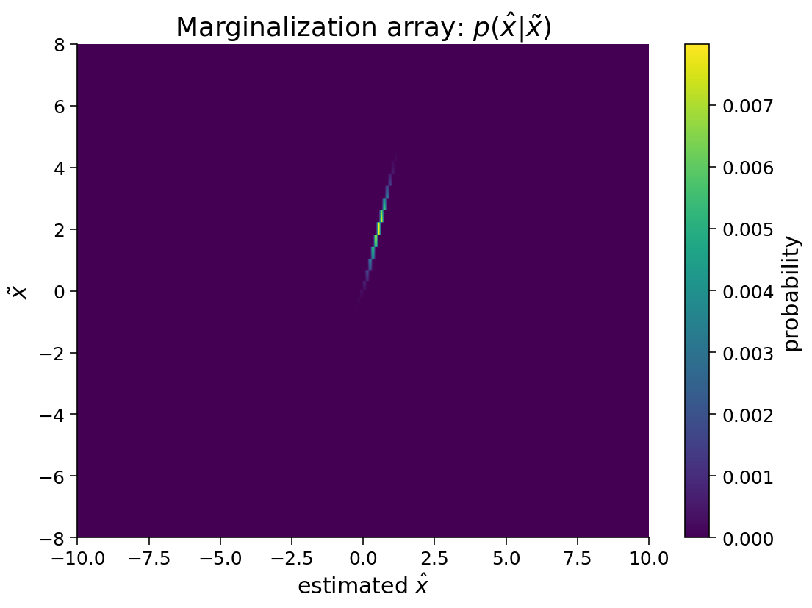
Simulation model
Inference the true x

Slide 52

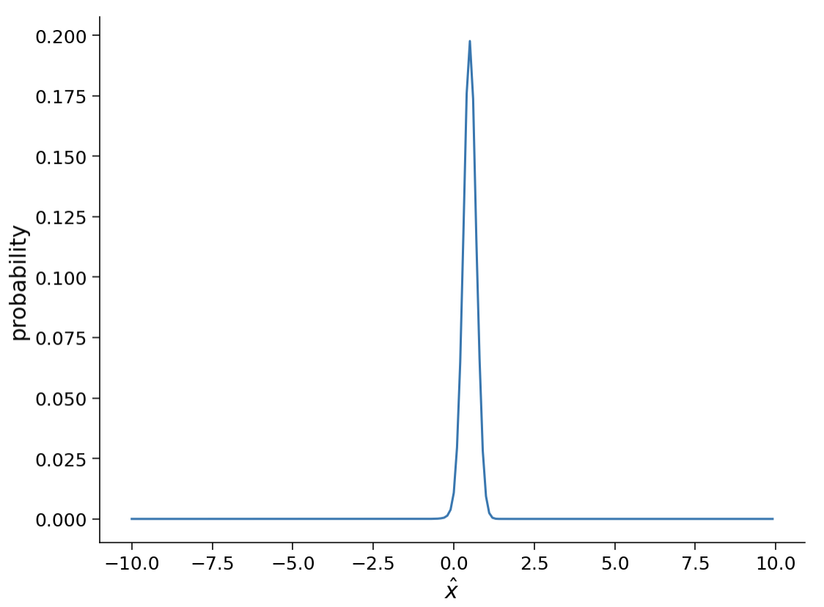
Simulation model
Model inversion
marginalization

Slide 53
Model spread
…… the generative model in question captures the way in which policies, actions, and states work together to generate rewards, and model inversion reveals the policy that best explains the occurrence of reward ……
…… Bayesian statistics mentioned above: The Bayesian calculations can be approximated by sampling from the relevant posterior probability distributions, rather than being computed directly.
Solway, A., Botvinick, M. (2012). Goal-Directed Decision Making as Probabilistic Inference: A Computational Framework and Potential Neural Correlates Psychological Review 119(1), 120-154. https://dx.doi.org/10.1037/a0026435
Zhu, J., Sanborn, A., Chater, N. (2020). The Bayesian sampler: Generic Bayesian inference causes incoherence in human probability judgments. Psychological Review https://dx.doi.org/10.1037/rev0000190

Slide 54
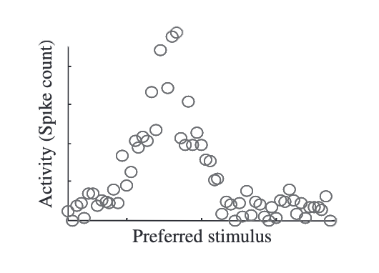
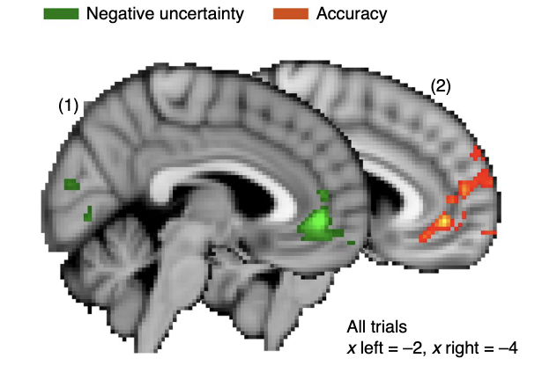
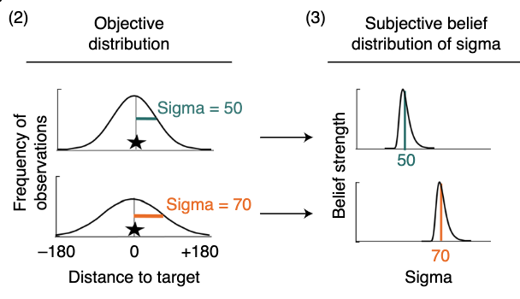
Neurologic evidence
Neuron level
Brain level
Beck, J., Ma, W., Latham, P., Pouget, A. (2007). Probabilistic population codes and the exponential family of distributions Progress in Brain Research 165(), 509-519. https://dx.doi.org/10.1016/s0079-6123(06)65032-2
Trudel, N., Scholl, J., Klein-Flügge, M., Fouragnan, E., Tankelevitch, L., Wittmann, M., Rushworth, M. (2020). Polarity of uncertainty representation during exploration and exploitation in ventromedial prefrontal cortex Nature Human Behaviour https://dx.doi.org/10.1038/s41562-020-0929-3

Slide 55
Review
Implementation
Algorithmic
Computational

Slide 56
The basics
Mathematics + Basic Applications

Slide 57
Basic mathematical knowledge
Linear Algebra
Probability Theory
Mathematical Statistics

Slide 58
Applied mathematics
Mathematical optimization
Bayesian Inference
Graph model
Linear system
……

Slide 59
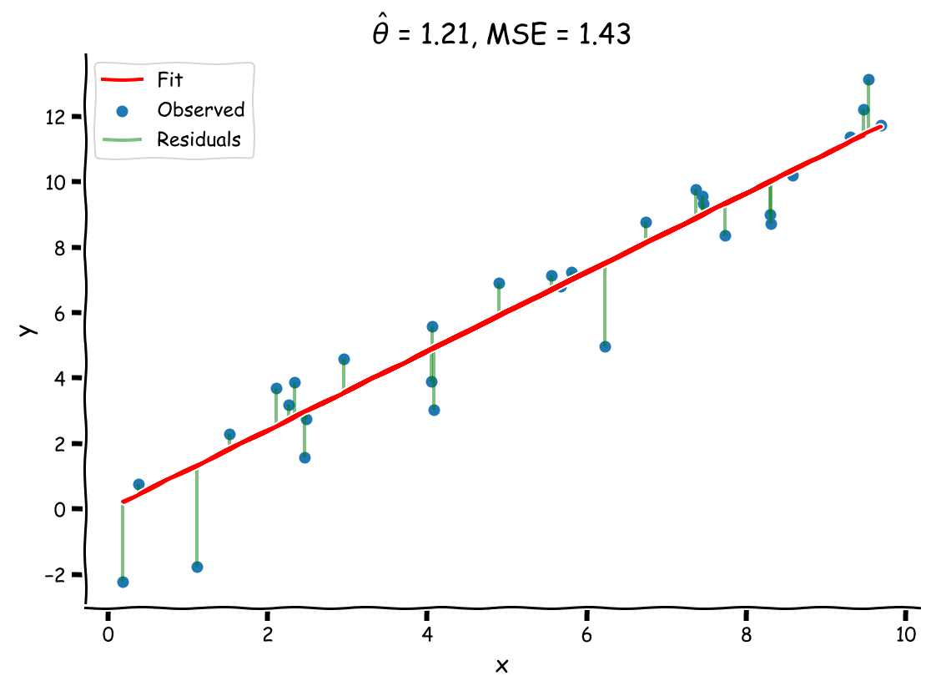
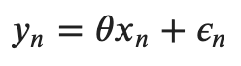
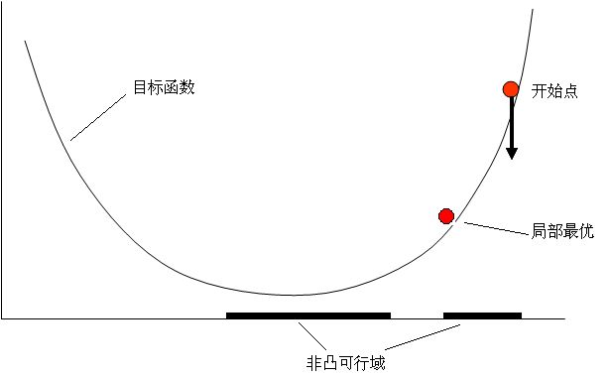
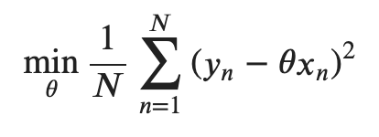
Mathematical optimization

Slide 60
Outro
Software Engineer

Slide 61
Software Engineer
Programming paradigm
Project Management
Unit Testing
Data Structure and Algorithms

Slide 62
Data Structure and Algorithms
O(3n)
VS
O(n)
List.append(X)
List[i] = X

Slide 63
Reference
Knill, D., Pouget, A. (2004). The Bayesian brain: the role of uncertainty in neural coding and computation Trends in Neurosciences 27(12), 712-719. https://dx.doi.org/10.1016/j.tins.2004.10.007
Solway, A., Botvinick, M. (2012). Goal-Directed Decision Making as Probabilistic Inference: A Computational Framework and Potential Neural Correlates Psychological Review 119(1), 120-154. https://dx.doi.org/10.1037/a0026435
Zhu, J., Sanborn, A., Chater, N. (2020). The Bayesian sampler: Generic Bayesian inference causes incoherence in human probability judgments. Psychological Review https://dx.doi.org/10.1037/rev0000190
Beck, J., Ma, W., Latham, P., Pouget, A. (2007). Probabilistic population codes and the exponential family of distributions Progress in Brain Research 165(), 509-519. https://dx.doi.org/10.1016/s0079-6123(06)65032-2
Trudel, N., Scholl, J., Klein-Flügge, M., Fouragnan, E., Tankelevitch, L., Wittmann, M., Rushworth, M. (2020). Polarity of uncertainty representation during exploration and exploitation in ventromedial prefrontal cortex Nature Human Behaviour https://dx.doi.org/10.1038/s41562-020-0929-3
Marr, D. (2010). Vision : A computational investigation into the human representation and processing of visual information / David Marr. Cambridge, Mass.: MIT Press.
https://github.com/NeuromatchAcademy/course-content/tree/master/tutorials

